Slide 1
Lecture 4
Techniques for creating deep modules

Slide 2
Agenda
Information hiding and leakage
General purpose modules are deeper
Different layer, different abstraction
Pull complexity downwards
Better together or better apart?
Define errors out of existence

Slide 3
Information hiding
Modules encapsulate knowledge representing design decisions.
The knowledge is embedded into the module but is invisible from the outside.
The hidden information is the details of how a mechanism is implemented.

Slide 4
Information hiding
Ultimate example: garbage collector – “no interface”
Red-black tree balancing mechanism
SQL query optimization
Intermediate representation optimization
TCP protocol implementation
tree.insert(node)
Hidden:
Mem alloc
Balancing
Ptrs handling
Etc…
a
a.Left subtree
b
c
b.Right subtree
Information hiding controls complexity by 1. simplifying the module’s interface, 2. avoiding additional dependencies on the hidden information

Slide 5
Information leakage
The same knowledge is used in multiple modules
E.g., file format in reader/writer (note the functional decomposition!).
Temporal decomposition
A sequence of functions implemented as modules
Overexposure
Default parameters don’t reflect the most common use case
Warning: information hiding only makes sense for those data that is unnecessary outside the module

Slide 6
General purpose modules are deeper
Specialization leads to complexity.
One of the best ways to create a deep module is to make its interface general-purpose.
Software is built for a specific purpose, so it cannot avoid specialization completely.
Questions to ask:
What is the simplest interface to cover all the current use cases?
In how many contexts will a module be used?
Is the API easy to use for today’s needs?

Slide 7
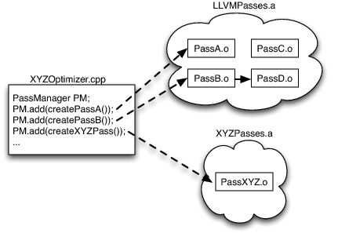
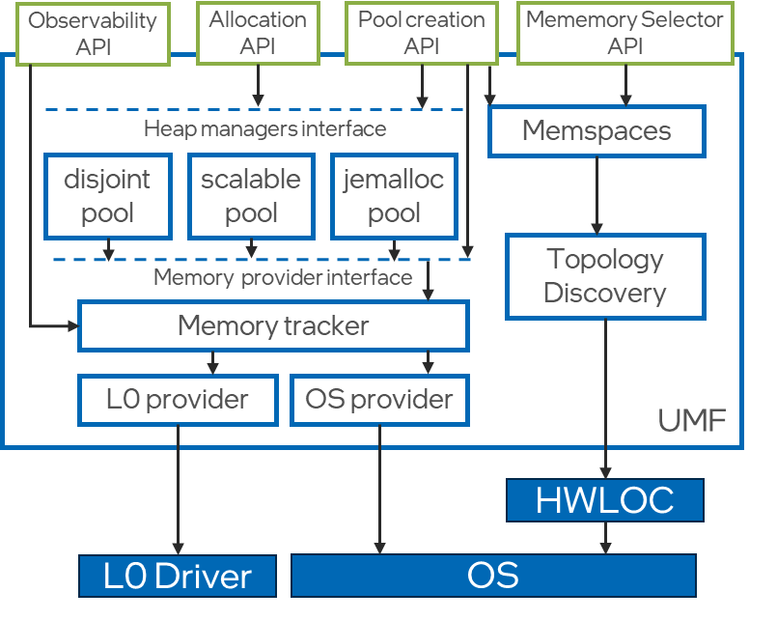
Separation of specialized code
Two principal options:
Push specialization upwards – the user is responsible for configuring a general-purpose module for their specific needs.
Example: pass mgr in LLVM
Push specialization downwards – define a general-purpose interface for plugins to implement.
Example: unified memory framework
A single interface for heap managers – multiple impls
A single interface for memory providers – multiple impls
*The Architecture of Open Source Applications (Volume 1) LLVM by C. Lattner

Slide 8
Special case handling
Design the normal case to automatically handle edge cases
Example?

Slide 9
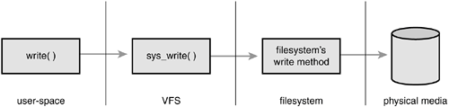
Abstraction layers
Software is built in abstraction layers
Layers provide different abstractions at each level
Problematic patterns include:
Pass-through methods
Pass-through variables
Wrappers & decorators
*The interface of a class usually uses different abstractions than the implementation
User-space layer deals with file descriptors and buffers.
VFS layer works with objects such as inode, dentry, superblock.
Linux supports many types of filesystems, so the next layer implements VFS operations.
Finally, the block I/O layer handles queues, schedules, mapping, etc.

Slide 10
Sinking complexity downwards
Most modules have more users than developers.
A simple interface is far more important than a simple implementation.
Conditions:
Complexity is closely related to the existing functionality.
Pulling it down results in some simplification somewhere.
Pulling it down simplifies the interface.
Example: configuration parameters push complexity up and delegate hard decisions to the user -> increase complexity

Slide 11
Together vs apart
Each piece of functionality can either be implemented together or apart – there are implications to the overall complexity.
The goal is twofold:
Improve modularity
Reduce complexity
Naïve assumption “a large number of small components is best” fails to comprehend subdivision complexity

Slide 12
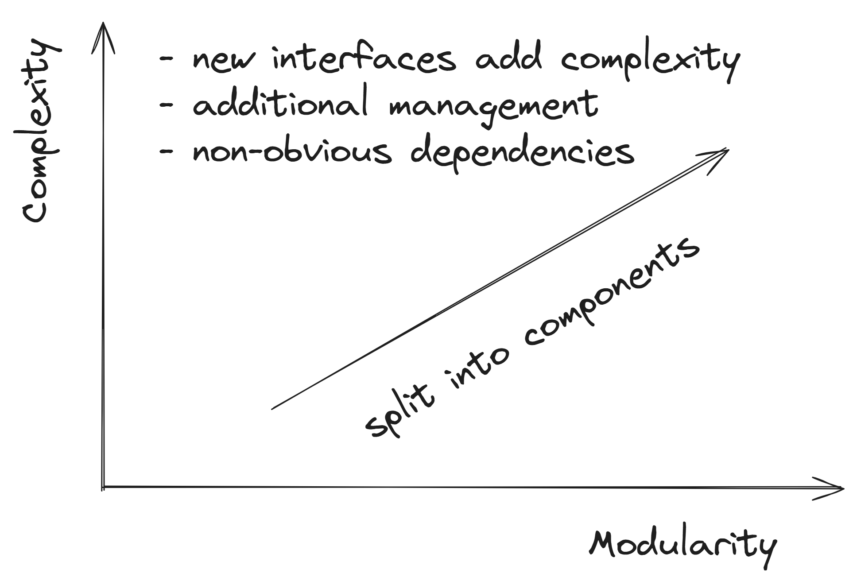
Together vs apart
Modularity is usually beneficial:
Modules are easier to understand
Composition and reuse is simpler
BUT
Modularizing often uses incorrect heuristics such as code length to make decisions leading to additional complexity

Slide 13
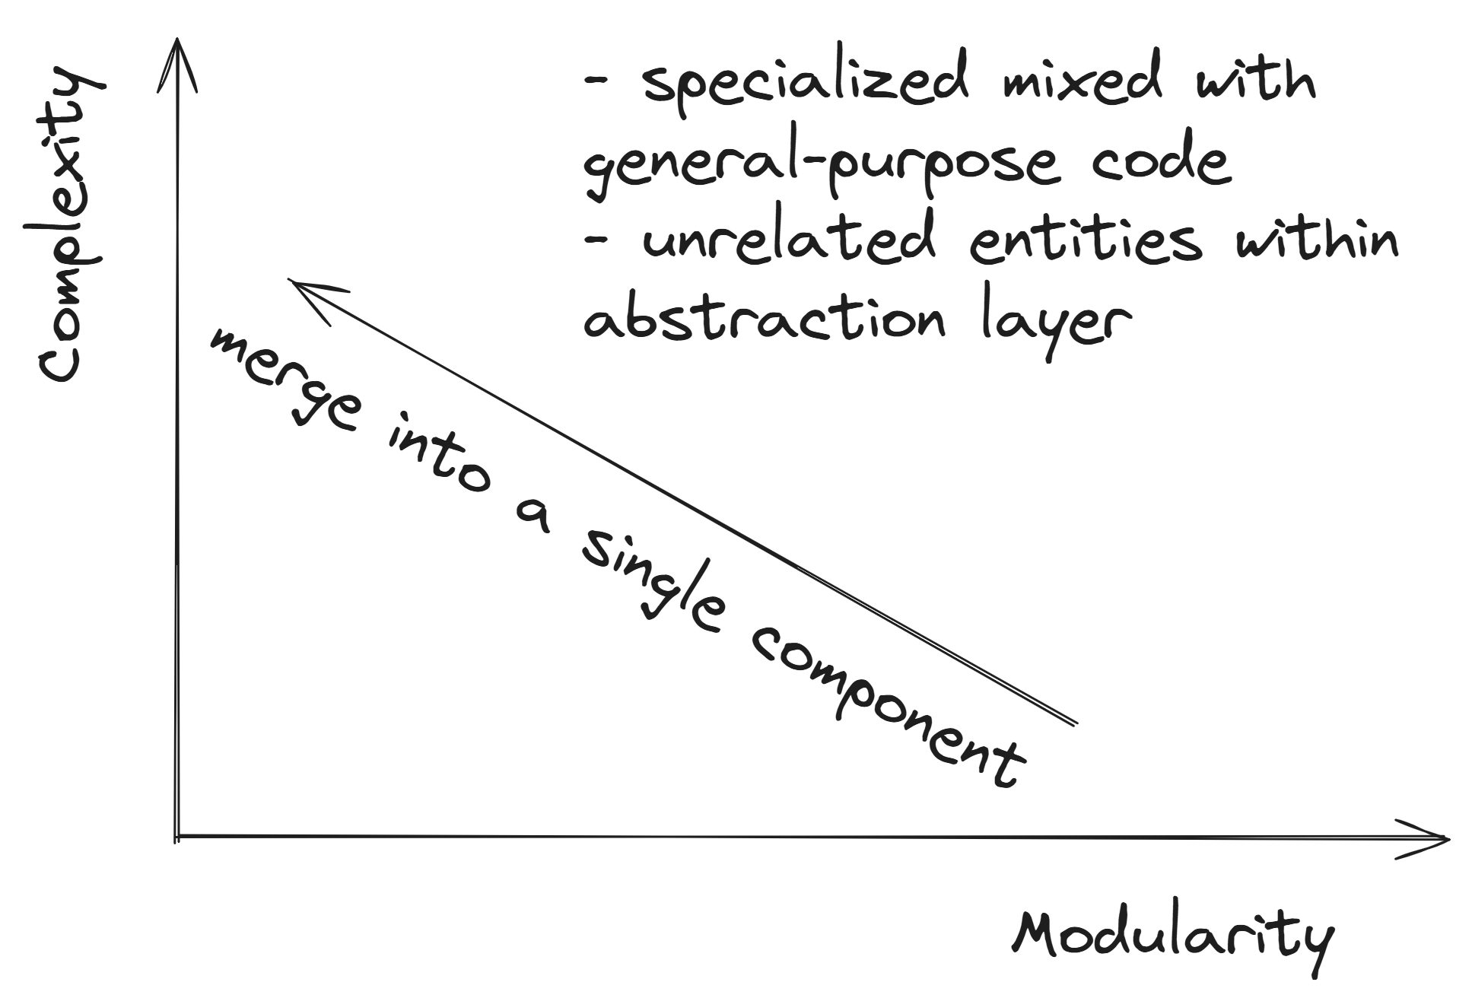
Together vs apart
Bringing components together can be beneficial when done right:
Shared information stored together – likely be used together
Simplified interface
Duplication eliminated
BUT
Insufficient modularization and non-clean abstractions lead to interface bloating and increased change complexity

Slide 14
Together vs apart
A module should perform a single “thing” and do it completely.
callers
implementation
interface
implementation
interface
implementation
interface
implementation
interface
Naming is important! (example for extracting a subtask).
Dividing functionality into two separate modules often doesn’t make sense.

Slide 15
Exceptions and complexity
Incorrect arguments
Failure to complete an operation (e.g., network failure)
Internal inconsistency
Languages with exception-handling mechanisms:
try { <some code that can throw an exception> }
catch (<exception type>) { <handling an exception> }

Slide 16
Exceptions and complexity
Incorrect arguments
Failure to complete an operation (e.g., network failure)
Internal inconsistency
Languages without exception-handling mechanisms:
response, err := html.Parse(resp.Body)
resp.body.Close()
If err != nil { <some error-handling code> }

Slide 17
Exceptions and complexity
Exceptions are a great source of complexity:
Difficult to cover by testing.
Debugging is complicated since the problem rarely occurs.
Language support is clunky.
Handling boilerplate code accounts for more lines than the common case.
Exceptions are part of the module’s interface! E.g., the infamous windows file deletion.
To reduce the complexity a system should reduce the number of places where exceptions need to be handled.

Slide 18
Exceptions and complexity
The most effective way of dealing with exception complexity is to redefine semantics to avoid exceptions altogether:
Redefine an operation (e.g., “make sure file is deleted, instead of delete a file”.
Exception masking (handling the exceptional situation at its source; e.g., making another attempt at a DB transaction).
Aggregation of exception handling and further dispatching.
Not handling. Crashing (e.g., out of memory).

Slide 19
Homework
Find and read the implementation of fopen in linux kernel.
Measure the SLOC and other types of complexity associated with it.
Describe its interface (formal and informal).
What abstractions are used?
What unimportant information do they hide?

